Slide 1





st
STOCK
MARKET
FORECAST
Student Details
NAME : Dhanush K
NM ID : au953121105007 COLLEGE NAME : THAMIRABHARANI ENGINEERING COLLEGE

Slide 2

Stock Market Forecast
Stock Market Forecast
Disclaimer
The content is curated from online/offline resources and used for educational purpose only

Slide 3

Stock Market Forecast
Stock Market Forecast
Course Outline
Abstract
Problem Statement
Aims, Objective & Proposed System/Solution System Deployment Approach
Model Development & Algorithm Future Scope
Conclusion

Slide 4


Stock Market Forecast
Stock Market Forecast
Abstract
This study evaluates the efficacy of machine
learning trends,
models focusing
in predicting stock market on the
S&P 500
index. We
with and
compare
traditional
statistical
methods
modern techniques
like random forests
neural networks,
considering various input highlight the relative
features. Results
performance of each model, aiding stakeholders in making informed investment decisions. This research contributes to advancing stock market prediction methodologies, empowering investors with more accurate forecasts.

Slide 5


Stock Market Forecast
Stock Market Forecast
Problem Statement
Despite the advancements in financial analysis techniques, accurately forecasting stock market trends remains a challenging task. Traditional methods often struggle to capture the complexities of dynamic market conditions, leading to suboptimal decision-making for investors and policymakers. In this context, there is a pressing need to explore and evaluate the efficacy of modern machine learning models in improving stock market forecasting accuracy. This research aims to address this gap by conducting a comparative analysis of machine learning techniques against traditional methods, with the goal of identifying the most effective approaches for predicting stock market movements.

Slide 6
Stock Market Forecast
Stock Market Forecast
Aim: This study aims to evaluate machine learning models' efficacy in forecasting stock market trends, particularly focusing on the S&P 500 index, to identify the most accurate predictive methods, thus assisting stakeholders in making informed investment decisions amidst market volatility.

Slide 7
Stock Market Forecast
Stock Market Forecast
Objectives
Model Selection: Evaluate and select suitable machine learning models and traditional statistical methods for forecasting S&P 500 trends.
Data Preprocessing: Prepare and preprocess historical financial data, including feature selection and normalization, to ensure compatibility with the chosen models.
Model Training and Validation: Train selected models using historical data and validate their performance through rigorous testing against real-world S&P 500 market data.
Performance Comparison and Analysis: Compare the predictive accuracy of the selected models, analyzing their strengths, weaknesses, and potential areas for improvement to provide insights for investors and stakeholders.

Slide 8

Stock Market Forecast
Stock Market Forecast
Proposed Solution
Combine forecasts from multiple models using ensemble methods to improve prediction accuracy by leveraging diverse model strengths.
Identify and select the most informative variables while reducing model complexity through feature selection techniques, enhancing predictive performance.
Optimize machine learning model parameters using hyperparameter tuning methods to maximize their effectiveness in predicting S&P 500 trends.
Regularly update the forecasting model with new data and recalibrate parameters to ensure adaptability to evolving market conditions and sustained accuracy.

Slide 9





Stock Market Forecast
Stock Market Forecast
System Deployment Approach
Proposed solution
Ensemble methods
Feature selection
Regular model updating
Hyperparameter Tuning

Slide 10
Stock Market Forecast
Stock Market Forecast
Model Development :
Data collection: Gather S&P 500 historical data, economic indicators, and sentiment analysis from diverse sources.
Preprocessing: Cleanse data, handle missing values, and normalize features to prepare for modeling.
Model selection: Choose appropriate algorithms like regression, decision trees, or neural networks based on data characteristics.
Training and evaluation: Train models on prepared data, evaluating performance using metrics like MSE or accuracy.
Optimization and deployment: Fine-tune model hyperparameters, consider ensemble methods, and deploy the best-performing model for real-time prediction.

Slide 11
Stock Market Forecast
Stock Market Forecast
ALGORITHM:
Random Forest: Employ an ensemble learning method that constructs multiple decision trees during training and outputs the average prediction of individual trees for robust prediction.
LSTM: Implement Long Short-Term Memory neural networks, adept at capturing temporal dependencies in sequential data like stock prices, facilitating accurate forecasting.
ARIMA: Apply AutoRegressive Integrated Moving Average models, suitable for time-series data, to capture trends and seasonality in S&P 500 movements.
Gradient Boosting Machine (GBM): Utilize gradient boosting to sequentially train weak learners, iteratively improving model performance by minimizing prediction errors.

Slide 12
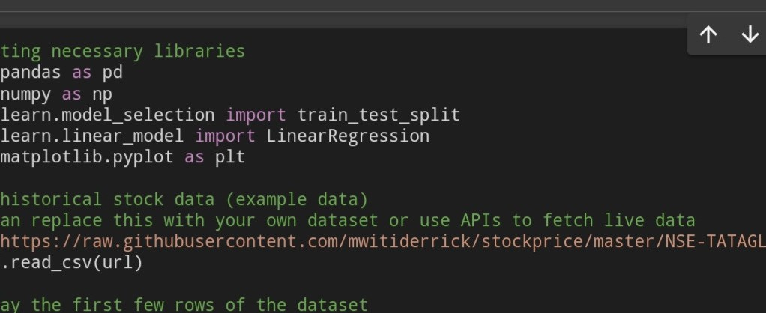
Stock Market Forecast Program:
Stock Market Forecast

Slide 13
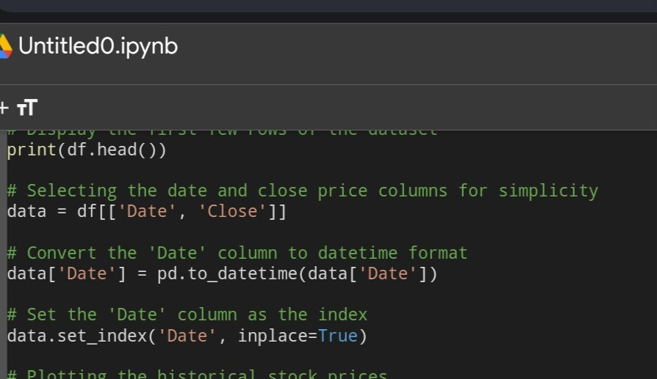
Stock Market Forecast
Stock Market Forecast

Slide 14
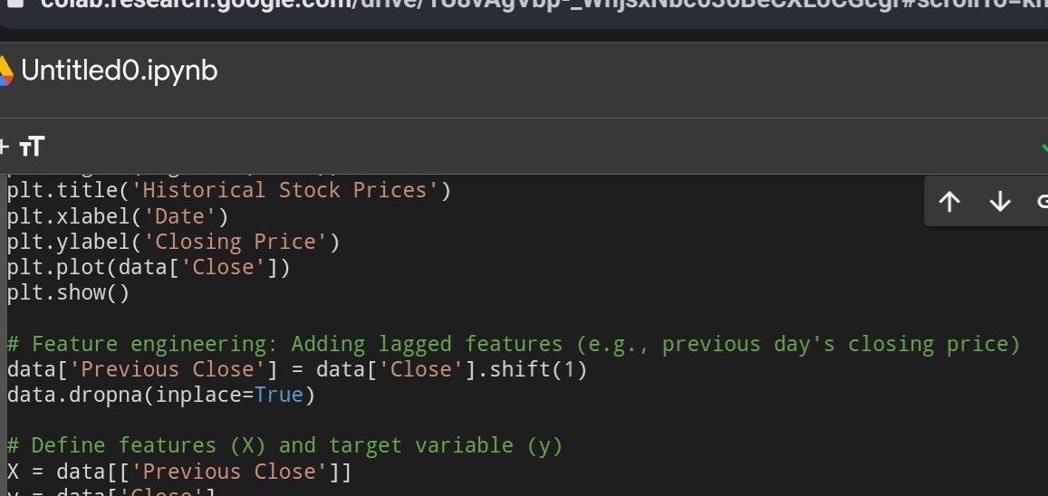
Stock Market Forecast
Stock Market Forecast

Slide 15
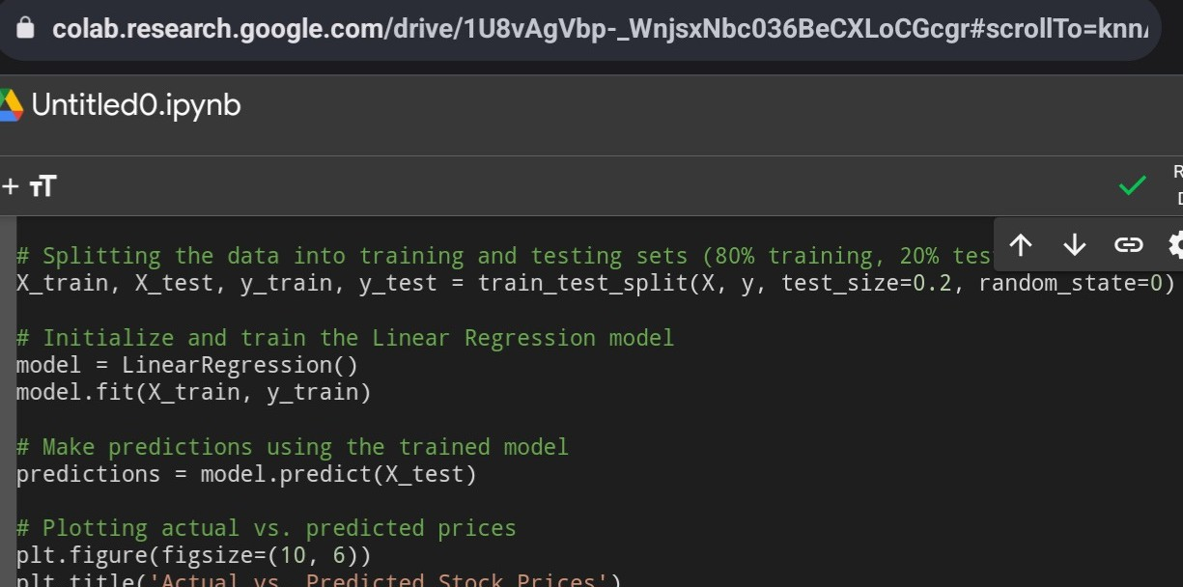
Stock Market Forecast
Stock Market Forecast

Slide 16
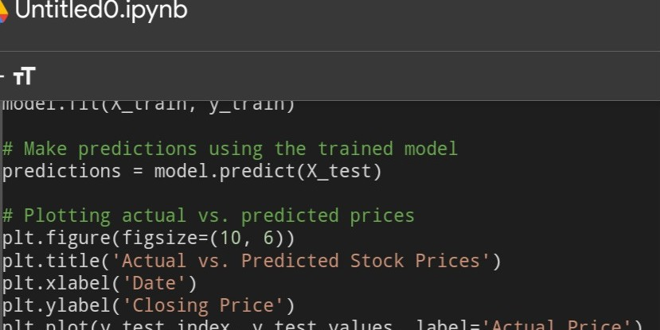
Stock Market Forecast
Stock Market Forecast

Slide 17
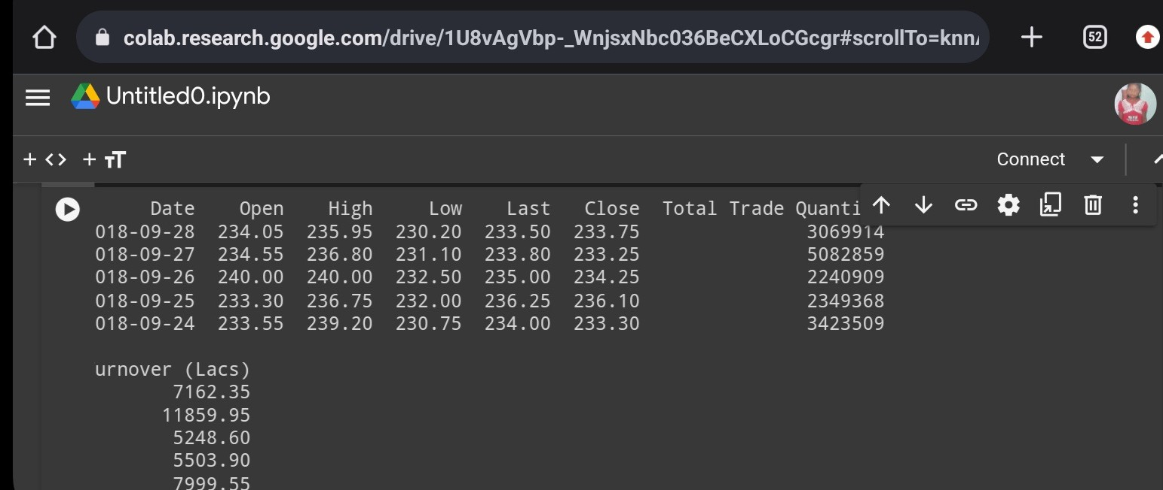
Stock Market Forecast
Result
Stock Market Forecast

Slide 18
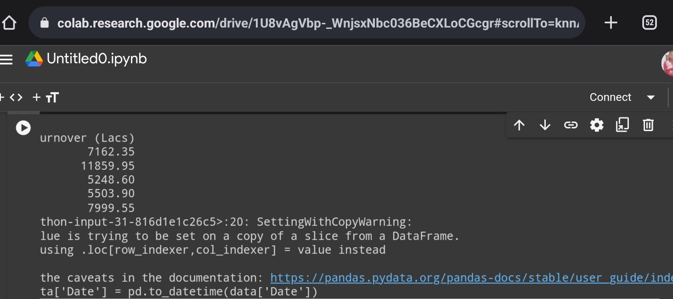
Stock Market Forecast
Stock Market Forecast

Slide 19
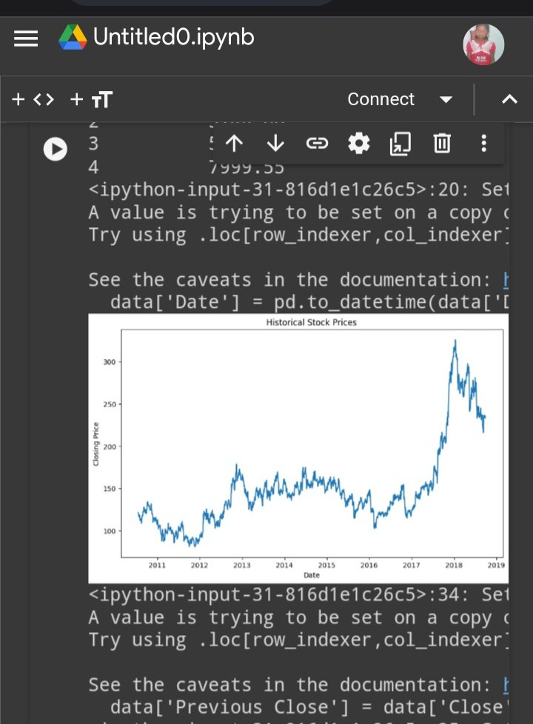
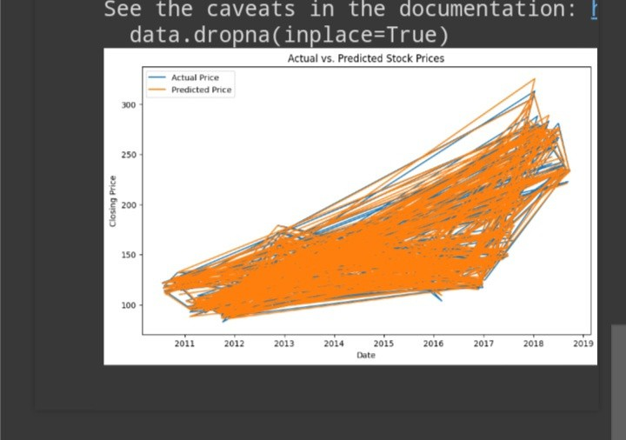
Stock Market Forecast
Stock Market Forecast

Slide 20

Stock Market Forecast
Stock Market Forecast
Future Scope
Advancements in AI and Data Analytics:
Refining Predictive Models: Enhancing accuracy through sophisticated algorithms.
Improving Market Forecasts: Leveraging big data for comprehensive analysis.
Shift Towards Personalized and Ethical Investing:
Tailored Solutions: Providing customized investment strategies based on individual preferences.
Ethical considerations: Integrating environmental, social, and governance (ESG) factors into predictive models for responsible investing.

Slide 21

Stock Market Forecast
Stock Market Forecast
Conclusion
In conclusion, the future of stock market forecasting is promising, driven by advancements in AI, data analytics, and personalized investing solutions. With refined predictive models and a focus on ethical considerations, investors can expect more accurate forecasts and opportunities for responsible investment strategies tailored to their needs.

Slide 22
Stock Market Forecast
Stock Market Forecast
Reference link:
1. Retrieved from http://www.theaustralian.com.au/ business/wealth/smaller-stocks-make-asx- inefficient-says-academic/storye6frgac6- 1226427548117. Accessed on July 28, 2012.
2.Retrieved from http://www.cmcrc.com/index.php/rd/academicpap ers/academic-papers. Accessed on September 30, 2011.

Slide 23
Stock Market Forecast
Stock Market Forecast
Thank you!

